Slide 1
Regional and Local Economic Effects from Proximity of High-Speed Rail Stations in Japan: Difference-in-Differences and Propensity Score Matching Analysis
Written by Jetpan Wetwitoo and Hironori Kato
Presented by Alex Ojemann

Slide 2
Background
High Speed Rail (HSR) can be a relatively cheap and environmentally friendly method of long distance travel
However, building and maintaining it can be extremely costly, so it must be justified by significant economic benefit
Japan has been one of the most successful nations at building HSR, but studies on its economic impact yield mixed results
This study uses a causal inference techniques to estimate the economic impact of some of the newer extensions to Japan’s HSR network

Slide 3
Study Design
Estimating effect of having a HSR in or near a region on economic measures
Includes models to estimate both the difference in means (ATT in this case) and the difference in the change in means over time
Includes models at both the prefecture level and the municipality level with necessary modifications
Outcome for prefectures: GRP
Outcome for municipalities: Tax revenue
Two control groups: one in which HSR never existed (Control Group 1) and one in which HSR existed before study (Control Group 2)

Slide 4
Methods/Results
1:1 Propensity score matching used for ATT estimates for prefecture model
1:1 ratio is used due to limited number of prefectures
Regression adjustment used to estimate difference in change of means over time
Difference in change of means over time is represented by an interaction term between time and treatment

Slide 5
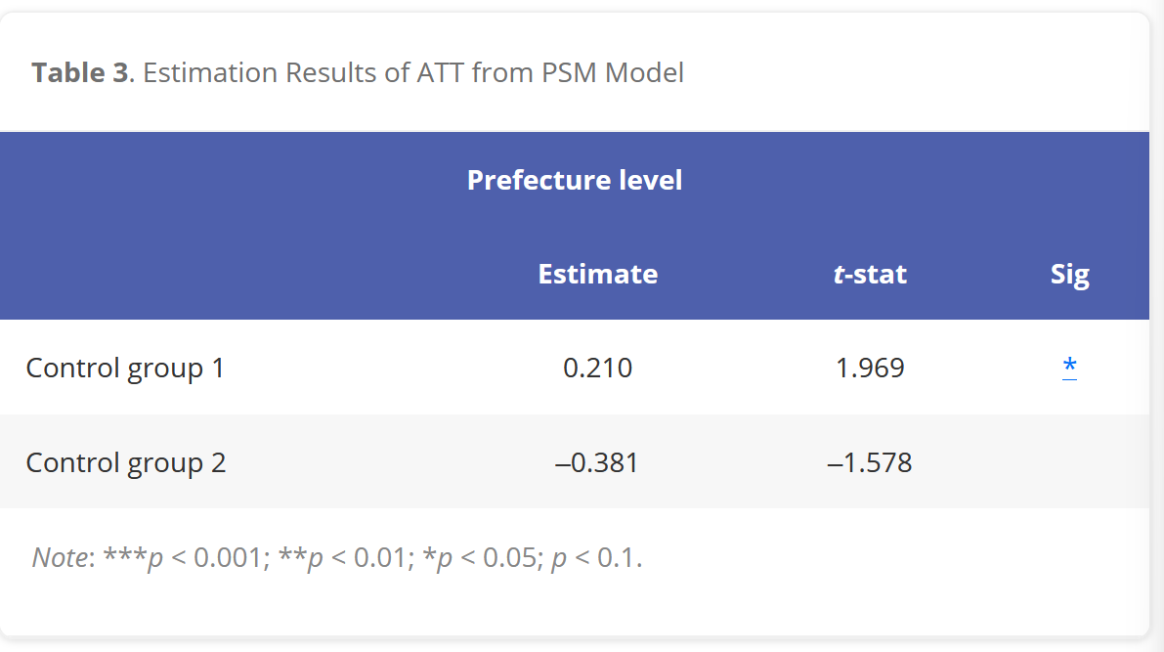

Slide 6
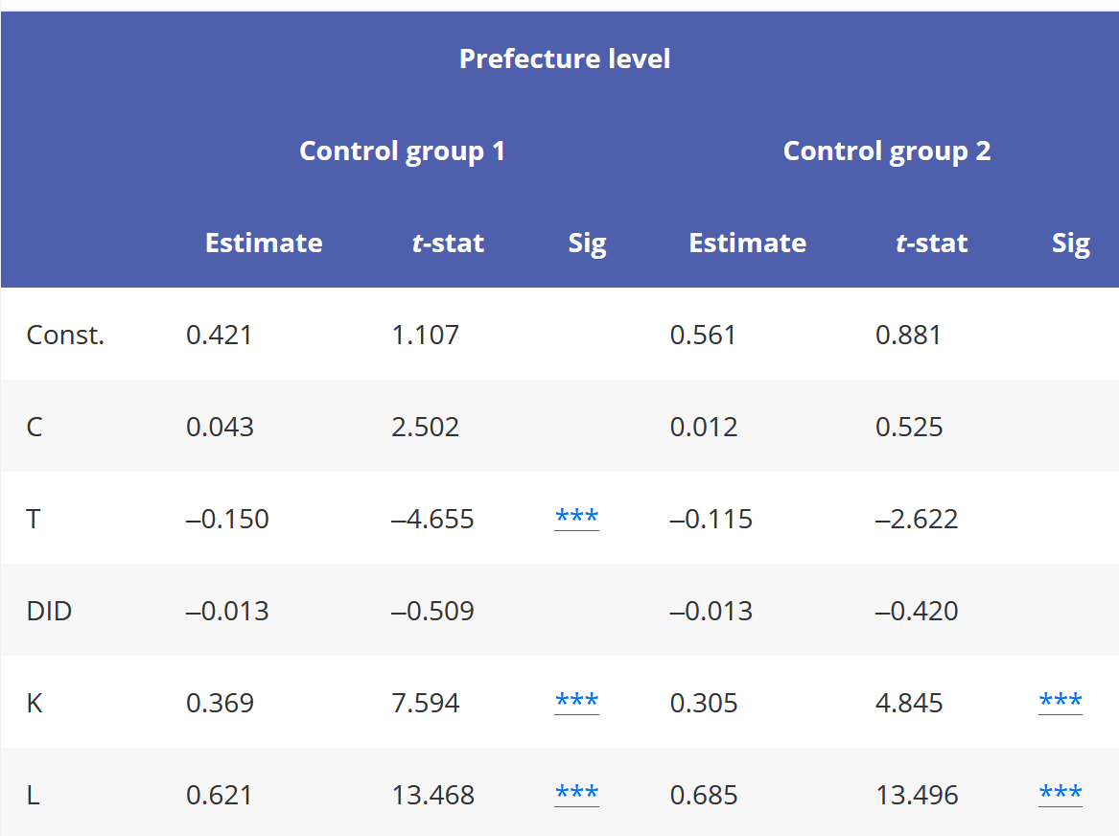

Slide 7
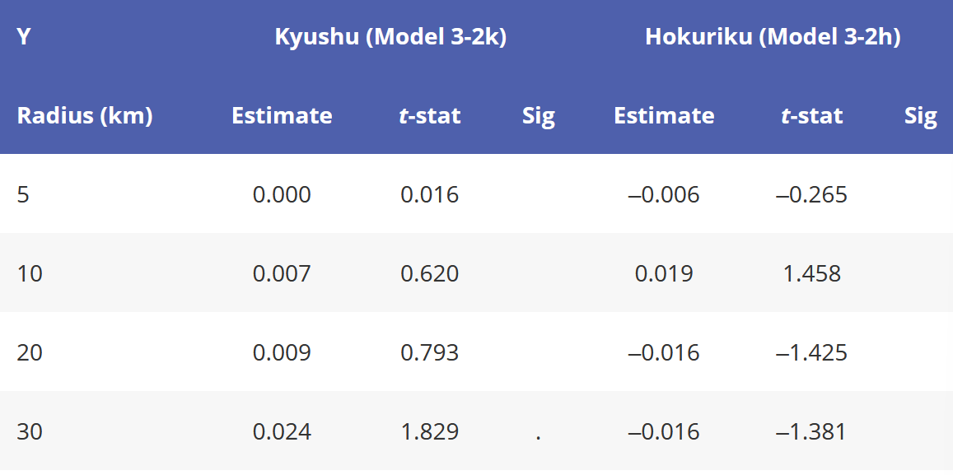

Slide 8
Discussion/Limitations
There is no significant economic boost due to the presence of nearby HSR services based on these results
In the big picture, this is particularly notable because Japan has been far more effective than many other nations in the development of HSR but are still not seeing conclusive economic benefits
One important limitation that the authors note of the study is that many of the HSR lines are still very new and have not had time to potentially affect economic development yet, particularly in the municipality case

